Slide 1
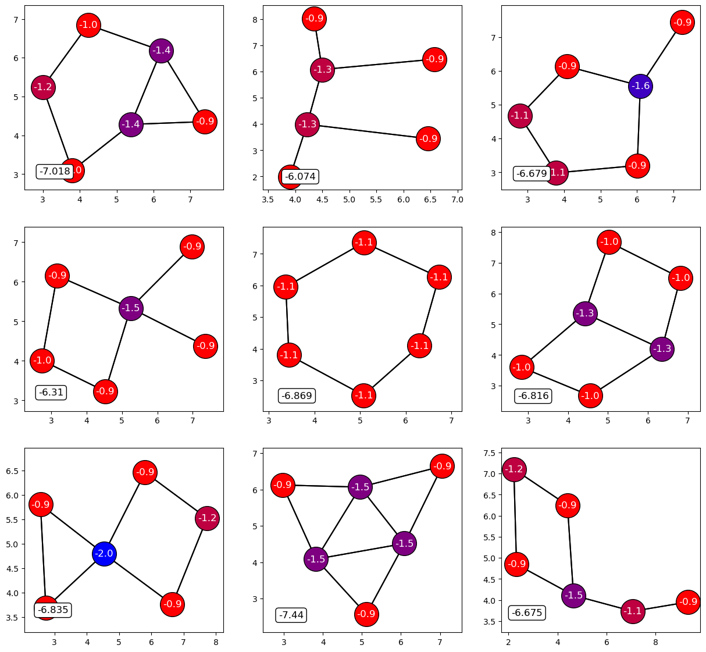
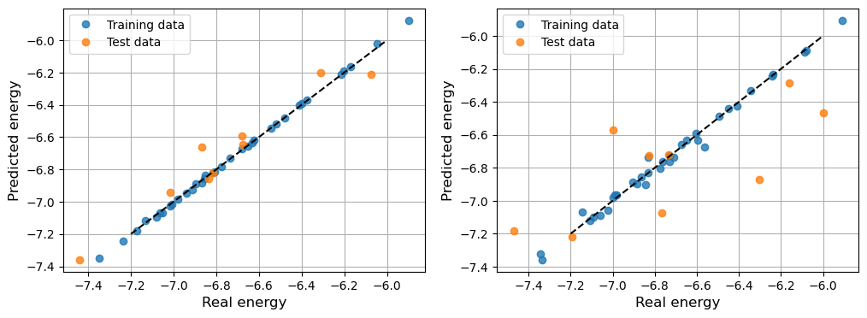
Molecular graphs

Slide 2
Outline
Goal: Understand Molecular graphs & usages
Introduction to graphs/Motivation
First introduce descriptors
How do we implement this?
Usage in Graph Neural Networks

Slide 3
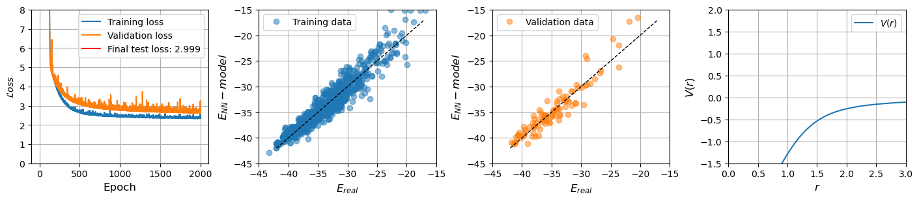
Introduction to graphs
Experiment: “Measured energies of different kinds of Molecules”
Classify different molecules → Need fingerprint
Perform experiment: Bond information very important to energy
How do we incorporate this?
Answer: Graphs

Slide 4
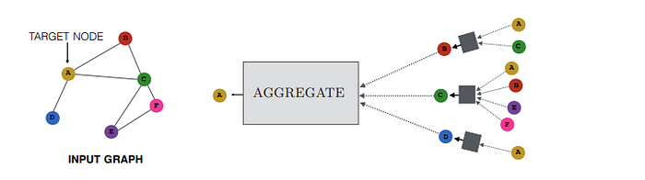
Introduction to graphs
Vertices/Nodes and edges →Flow of information
Very similar to molecule
How do we describe this mathematically?

Slide 5
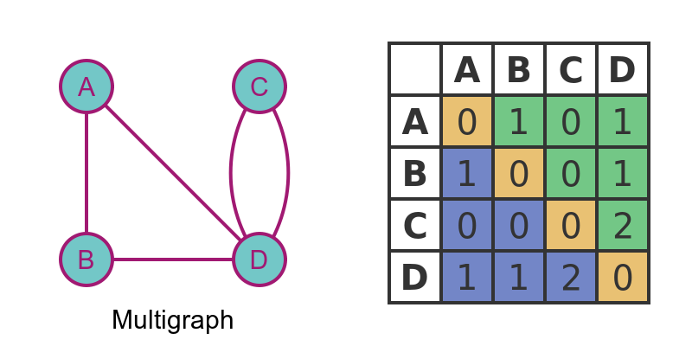

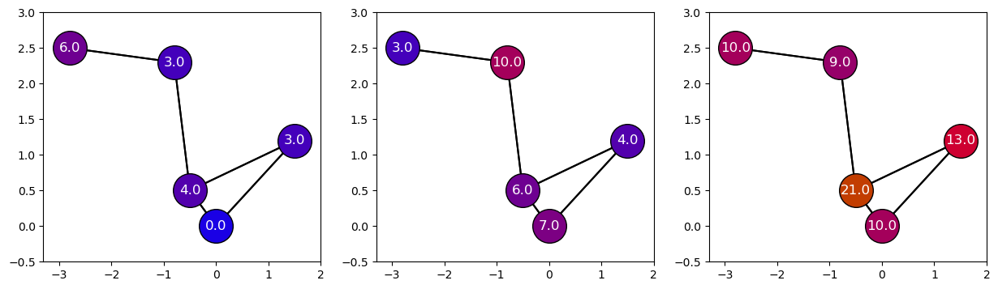
How do we implement this?
Idea from PairWiseDistanceMatrix → Adjacency matrix
Equivalent
Increasing Layer

Slide 6
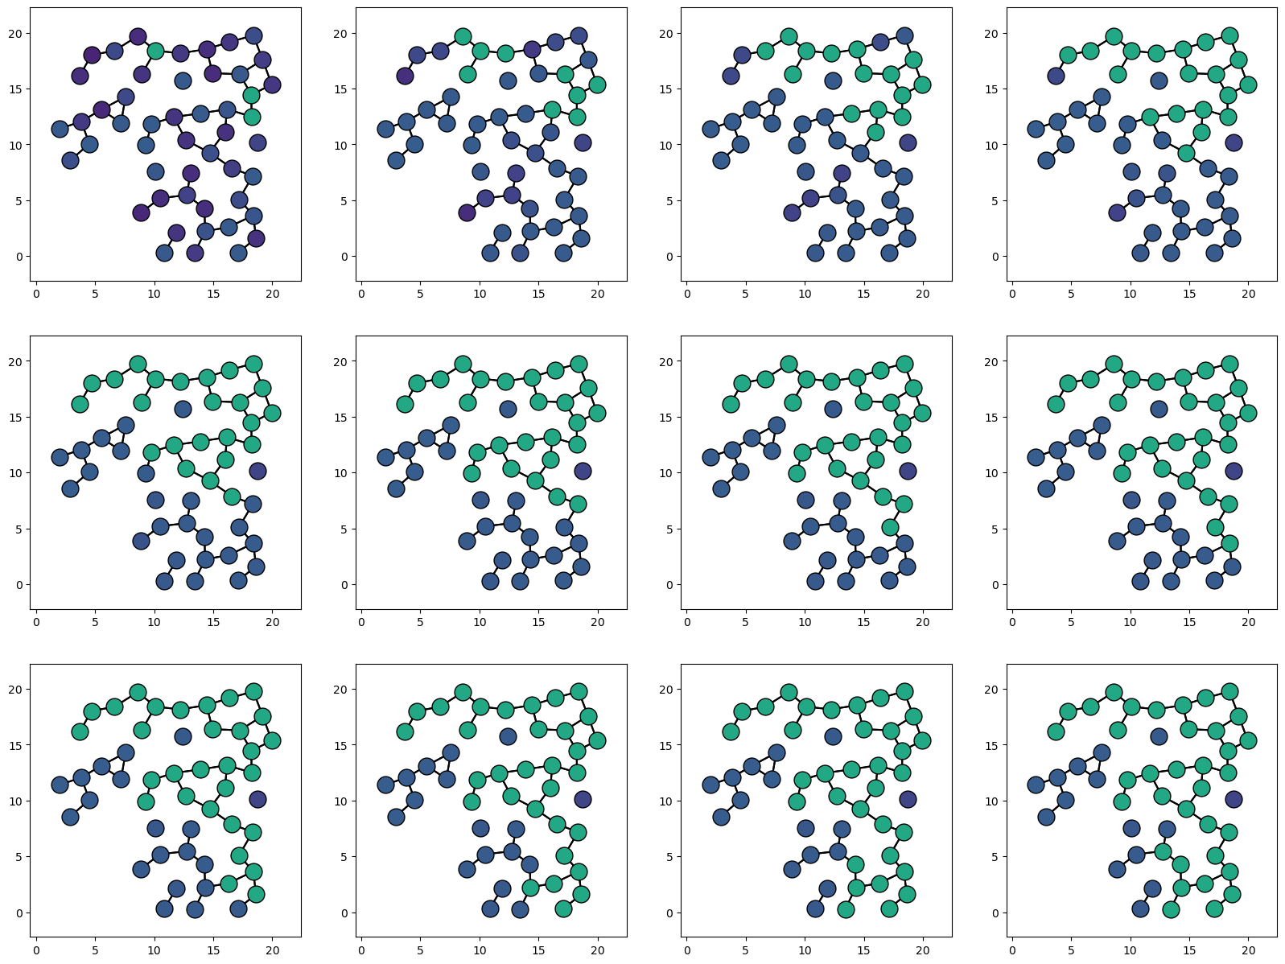
How do we implement this?
Layers like regular NN
Maybe use all this as a NN and call it Graph Neural network?

Slide 7

How much can we generalize and learn?
Nodes and edges can have features
Construct messages & aggregate → Message Passing
We have to aggregate information in some way?
Sums it all up:

Slide 8
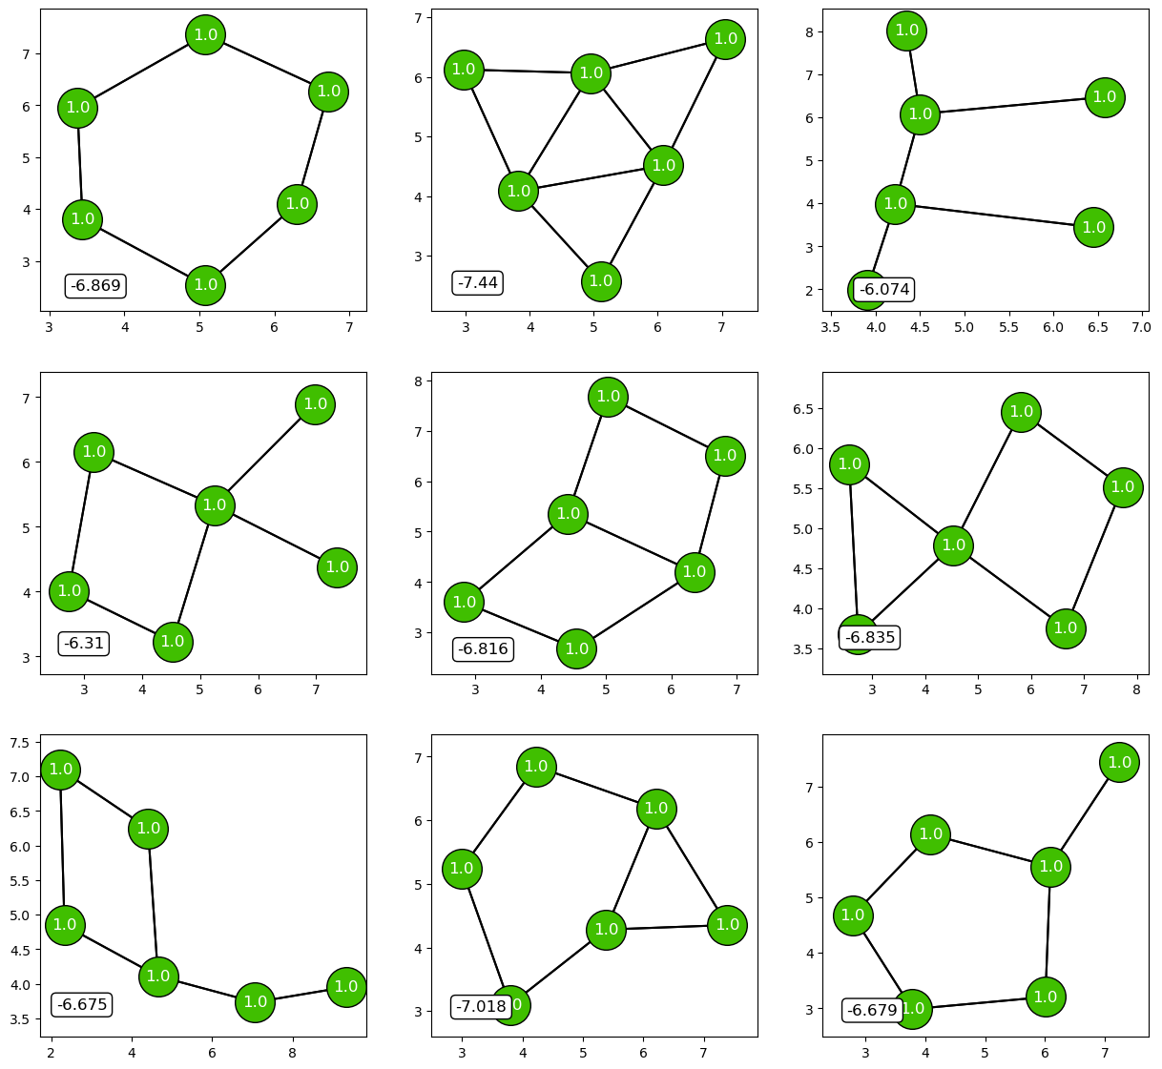
Example: Exercise 62
Modified
Try and fit Tight-Binding energies using GCNN
Data given: Graph type & global energies
2 types of energies:
Modified & Unmodified

Slide 9
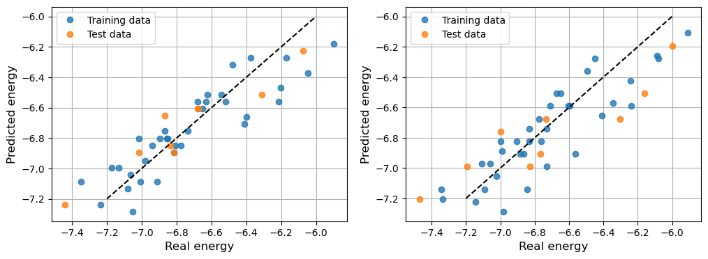
Example: Exercise 62
2 GCNN Layers
Perhaps add more layers?
Modified
Unmodified

Slide 10
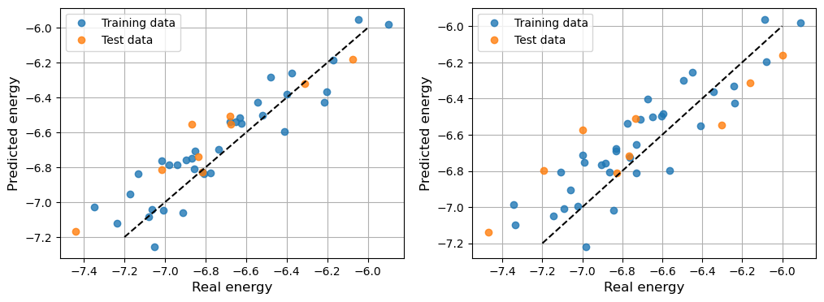
Example: Exercise 62
4 GCNN Layers
Modified
Unmodified

Slide 11
Example: Exercise 62
4 GCNN Layers + Activation + Head – Layers
Tight-Binding model → Geometrical
Probably memorized and not learnt
Modified
Unmodified

Slide 12

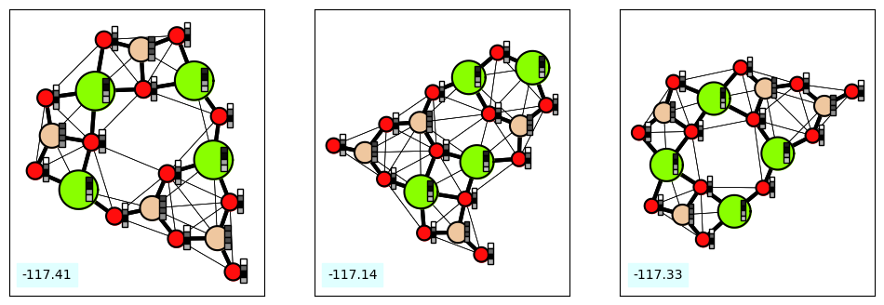
Different Example: Include bonds
Include atom features & Bond features

Slide 13
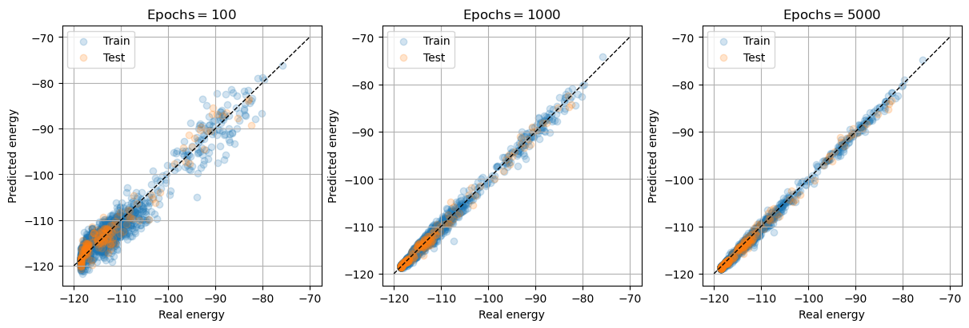
Different Example: Include bonds

Slide 14
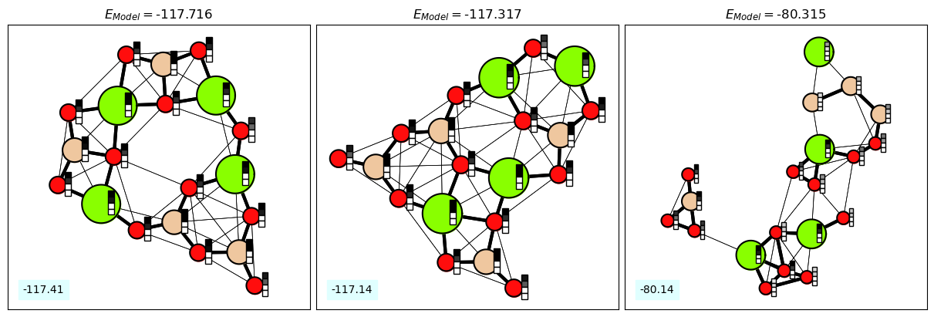
Different Example: Include bonds

